Slide 1

SUPERMART GROCERY SALES - RETAIL ANALYTICS DATASET
Notes:
Line spacing + Page numbers

Slide 2
Overview
Grocery Stores are a vital part of everyday life, providing us with the food and essentials as we need. Many people utilize grocery delivery applications to order their products, making it easy to shop from home. Each transaction made through these applications is recorded in detail, creating a valuable dataset. This project looks at data from these transactions to understand how well these stores are performing. The dataset is sourced from Kaggle and simulates grocery sales activities within Tamil Nadu state of India. The dataset includes various columns that provide detailed information about each transaction at the Supermarket.
Dataset Size:
Rows: 9994
Columns: 15

Slide 3
Dataset Structure
Order ID | Customer Name | Category | Sub Category | City | Order Date | Region | Sales | Discount | Profit | State
OD1 | Harish | Oil & Masala | Masalas | Vellore | 11-08-2017 | North | 1254 | 0.12 | 401.28 | Tamil Nadu
OD2 | Sudha | Beverages | Health Drinks | Krishnagiri | 11-08-2017 | South | 749 | 0.18 | 149.8 | Tamil Nadu
OD3 | Hussain | Food Grains | Atta & Flour | Perambalur | 06-12-2017 | West | 2360 | 0.21 | 165.2 | Tamil Nadu
OD4 | Jackson | Fruits & Veggies | Fresh Vegetables | Dharmapuri | 10-11-2016 | South | 896 | 0.25 | 89.6 | Tamil Nadu
OD5 | Ridhesh | Food Grains | Organic Staples | Ooty | 10-11-2016 | South | 2355 | 0.26 | 918.45 | Tamil Nadu
OD6 | Adavan | Food Grains | Organic Staples | Dharmapuri | 06-09-2015 | West | 2305 | 0.26 | 322.7 | Tamil Nadu
OD7 | Jonas | Fruits & Veggies | Fresh Vegetables | Trichy | 06-09-2015 | West | 826 | 0.33 | 346.92 | Tamil Nadu
OD8 | Hafiz | Fruits & Veggies | Fresh Fruits | Ramanadhapuram | 06-09-2015 | West | 1847 | 0.32 | 147.76 | Tamil Nadu
OD9 | Hafiz | Bakery | Biscuits | Tirunelveli | 06-09-2015 | West | 791 | 0.23 | 181.93 | Tamil Nadu

Slide 4
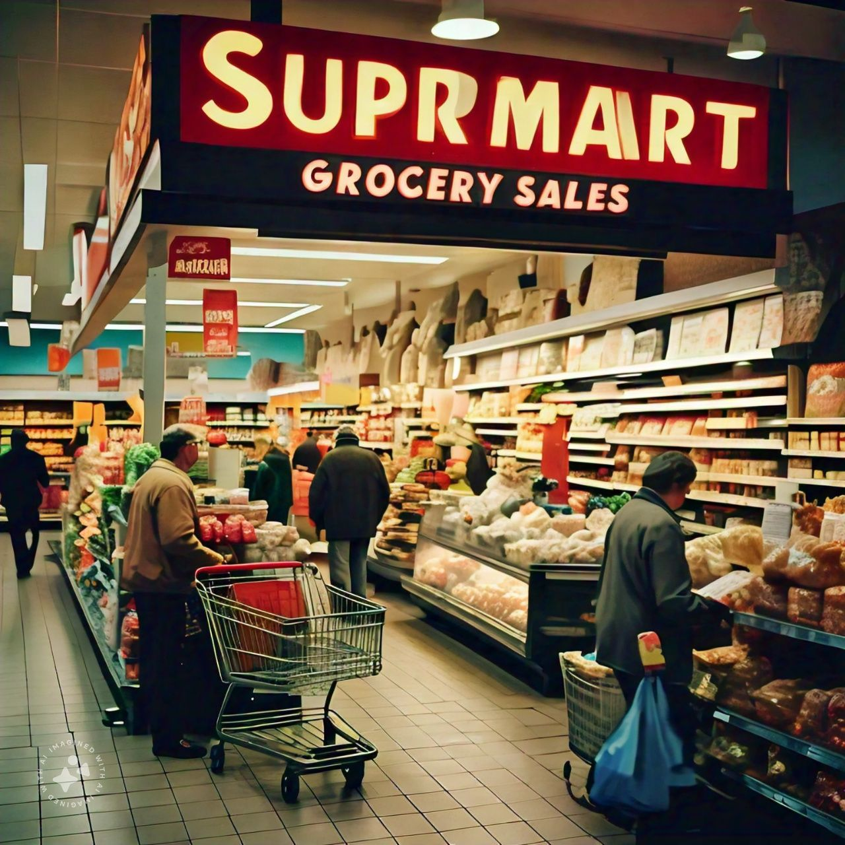
Aim
The aim of this study is to perform an Exploratory Data Analysis (EDA) on the retail sales dataset to uncover key insights regarding sales performance, customer behavior, regional trends, discount impact, and profitability. This analysis will help identify factors that influence sales, evaluate promotional strategies, and determine which products and regions contribute most to the overall profitability of the store.

Slide 5
Objectives
Analyze sales performance and profitability across different product categories, cities, and regions to identify trends, potential improvements, and areas of focus for maximizing revenue and profit.
Identify Top-Performing Products and Regions: Understand which products and regions generate the most sales and profits.
Examine Seasonal Trends: Explore how sales change across different months and seasons to better understand demand patterns.
Assess the Impact of Discounts on Profitability: Evaluate the relationship between discount levels and profit margins to optimize promotional strategies.
Customer Segmentation Analysis: Analyze customer segments to identify high-value customers and tailor marketing efforts.

Slide 6
Data Cleaning and Transformation
Missing values handling: Handling missing values in key columns, by either inputting or removing rows, ensuring data completeness.
Standardizing Date formats: Dates having multiple formats so that replace ‘/’ with ‘-’ this and convert the object format to datetimes format.
Duplicate values checking: To ensure no duplicates in the dataset
Feature Engineering: Add new columns like ‘Year’, ‘Month’, ‘Profit Margin’, ‘Discount Range’ for better insights

Slide 7
Data Transformation and Key Column Additions
For better insights, the following new columns were added to the dataset:
Year: Extracted from the Order Date, this column helps in performing year-wise trend analysis.
Month: Also extracted from the Order Date, this enables month-over-month performance comparison.
Profit Margin: This column is calculated as (profit / sales) * 100 to understand the profitability ratio for each transaction.
Discount Range: This column classifies discount values into predefined bins like ‘0-10%’, ’10-20%’, etc. to analyse how discount level impact profitability

Slide 8
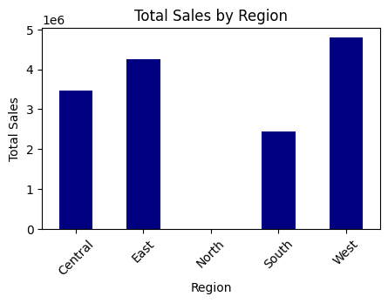
Total sales per region
df.groupby('Region')['Sales'].sum()
Region | Sales
Central | 3468156
East | 4248368
North | 1254
South | 2440461
West | 4798743
The West region leads in sales with 4,798,743, followed by the East (4,248,368) and South (2,440,461), while the North has the lowest at 1,254.

Slide 9
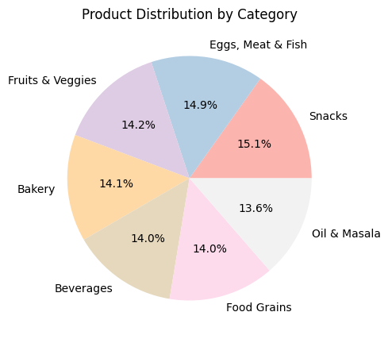
Count the number of products in each category
df['Category'].value_counts()
Category | Count
Snacks | 1514
Eggs, Meat & Fish | 1490
Fruits & Veggies | 1418
Bakery | 1413
Beverages | 1400
Food Grains | 1398
Oil & Masala | 1361
Snacks lead with 1,514 counts, followed by eggs, meat & fish (1,490), while oil & masala (1,361) have the lowest.

Slide 10
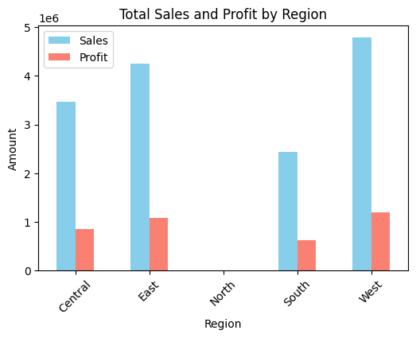
Total sales and profit by region df.groupby('Region')[['Sales','Profit']].sum()
Region | Sales | Profit
Central | 3468156 | 856806.84
East | 4248368 | 1074345.58
North | 1254 | 401.28
South | 2440461 | 623562.89
West | 4798743 | 1192004.61
Central: 3.47M sales, 856.8K profit; East: 4.25M sales, 1.07M profit; North: 1.25K sales, 401 profit; South: 2.44M sales, 623.6K profit; West: 4.80M sales, 1.19M profit.

Slide 11
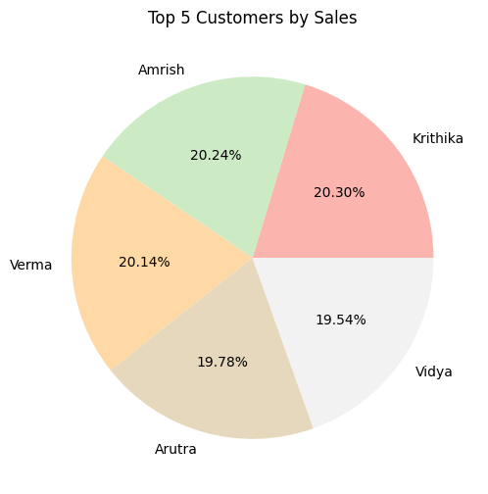
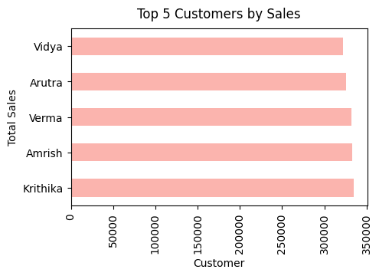
Identify the top 5 customers based on their total sales in the dataset
Customer Name | Sales
Krithika | 334361
Amrish | 333351
Verma | 331665
Arutra | 325720
Vidya | 321798
This dataset shows the sales for different customers. Krithika has the highest sales with 334,361 units, followed by Amrish with 333,351 units, and Verma with 331,665 units. Arutra and Vidya sold 325,720 and 321,798 units, respectively. It seems to rank the customers based on their sales.

Slide 12
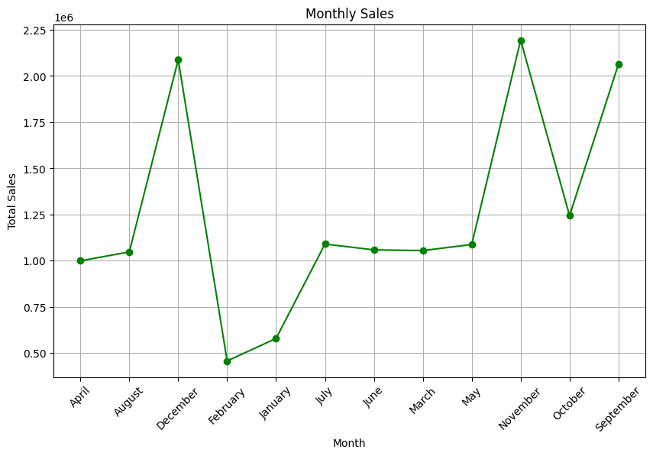
Monthly Sales Trend
df.groupby('Month')['Sales'].sum().reset_index()
Month | Sales
April | 998453
August | 1046807
December | 2088076
February | 456102
January | 577972
July | 1089385
June | 1057808
March | 1053980
May | 1086920
November | 2193924
October | 1243289
September | 2064266

Slide 13
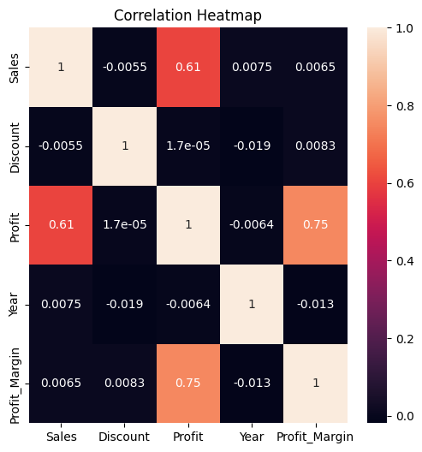
Correlation Analysis
Using a heatmap to visualize the correlation between numerical features
corr = df.corr(numeric_only=True)
plt.figure(figsize=(6,6))
sns.heatmap(corr, annot=True)
plt.title('Correlation Heatmap')
plt.show()
Sales and Profit show a moderate positive relationship, while Profit and Profit_Margin are strongly positively correlated. Discounts and Year have little to no significant impact.

Slide 14
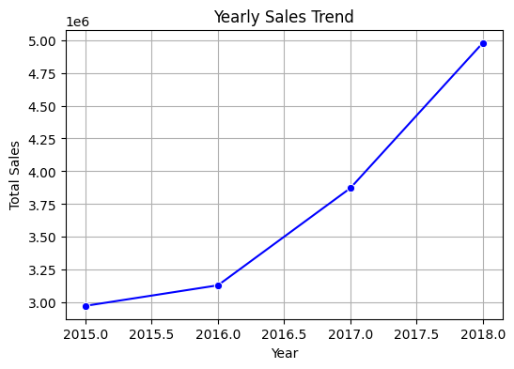
Sales Distribution by Year
Year | Sales
2015 | 2975599
2016 | 3131959
2017 | 3871912
2018 | 4977512
The dataset shows sales data over the years. Starting in 2015, sales were around 2.98 million, increasing steadily each year. By 2016, sales grew to about 3.13 million, reaching 3.87 million in 2017, and further rising to nearly 4.98 million in 2018. This indicates consistent growth in sales year over year.

Slide 15
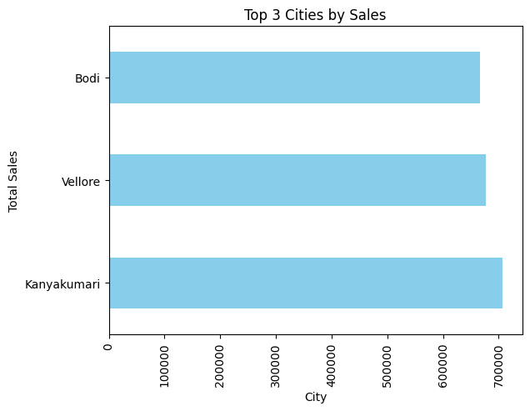
Top three cities with the highest sales?
City | Sales
Kanyakumari | 706764
Vellore | 676550
Bodi | 667177
The top three cities with the highest sales are Kanyakumari with 706,764, Vellore with 676,550, and Bodi with 667,177.

Slide 16
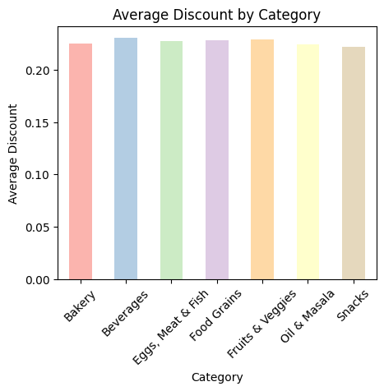
Average Discount by Category
Category | Discount
Bakery | 0.225428
Beverages | 0.230329
Eggs, Meat & Fish | 0.227792
Food Grains | 0.228548
Fruits & Veggies | 0.229295
Oil & Masala | 0.224526
Snacks | 0.222048
The analysis reveals that Beverages have the highest average discount at 23.03%, followed by Fruits & Veggies at 22.93%. Snacks receive the lowest discount at 22.20%. Overall, the discount rates across all categories are fairly similar, ranging from 22.20% to 23.03%.

Slide 17
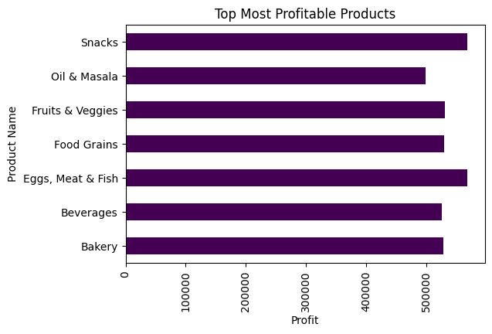
Top most profitable products
df.groupby('Category')['Profit'].sum()
Category | Profit
Bakery | 528521.06
Beverages | 525605.76
Eggs, Meat & Fish | 567357.22
Food Grains | 529162.64
Fruits & Veggies | 530400.38
Oil & Masala | 497895.29
Snacks | 568178.85
The analysis shows that Snacks generated the highest profit at 568,178.85, closely followed by Eggs, Meat & Fish at 567,357.22. Oil & Masala had the lowest profit at 497,895.29. Overall, profits vary moderately across categories.

Slide 18
Identify which categories contribute the most to total sales.
Category | Sales
Eggs, Meat & Fish | 2267401
Snacks | 2237546
Food Grains | 2115272
Bakery | 2112281
Fruits & Veggies | 2100727
Beverages | 2085313
Oil & Masala | 2038442
The analysis shows "Eggs, Meat & Fish" as the top-selling category, followed by "Snacks" and "Food Grains." Sales across categories like "Bakery," "Fruits & Veggies," and "Beverages" are consistent, while "Oil & Masala" ranks lowest but remains essential. Overall, demand is well-distributed, with growth potential in lower-performing categories.
City with Maximum Profit
City | Profit
Vellore | 174073.01
The city with the highest profit is identified. Vellore might generate the highest profits.

Slide 19
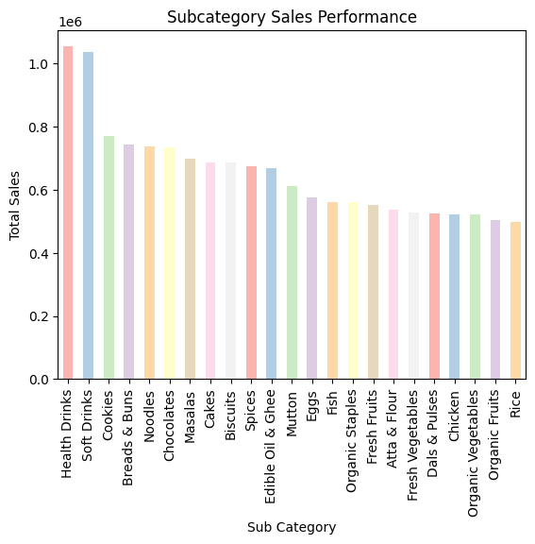
Subcategory Sales Performance
Sub Category | Sales
Health Drinks | 1051439
Soft Drinks | 1033874
Cookies | 768213
Breads & Buns | 742586
Noodles | 735435
Chocolates | 733898
Masalas | 697480
Cakes | 685612
Biscuits | 684083
Spices | 672876
Edible Oil & Ghee | 668086
Mutton | 611200
Eggs | 575156
Fish | 560548
Organic Staples | 558929
Fresh Fruits | 551212
Atta & Flour | 534649
Fresh Vegetables | 525842
Dals & Pulses | 523371
Chicken | 520497
Organic Vegetables | 520271
Organic Fruits | 503402
Rice | 498323
df.groupby('Sub Category')['Sales'].sum().sort_values(ascending=False)

Slide 20
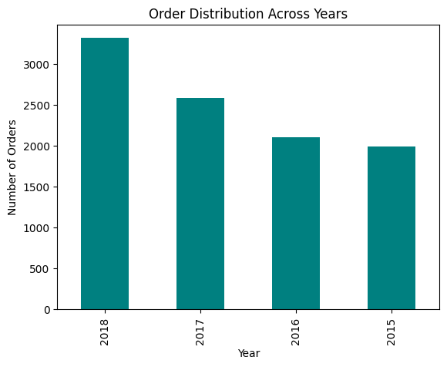
Evaluate the distribution of orders over years.
df['Order_Date'].dt.year.value_counts()
Order_Date | Count
2018 | 3312
2017 | 2587
2016 | 2102
2015 | 1993
The data indicates a steady and consistent increase in orders over the years, with the sharpest growth occurring between 2017 and 2018.

Slide 21
How do sales differ between weekdays and weekends
df['Weekday’]=df['Order_Date'].dt.day_name()
df.groupby('Weekday')['Sales'].sum()
Highest Sales: Tuesday (2,855,751)
Other Strong Days: Monday (2,428,324) and Saturday (2,724,409)
Average Sales: Sunday (2,615,647) and Wednesday (1,886,849)
Lowest Sales: Thursday (807,635)
Tuesday has the highest sales, while Thursday is the weakest day. The weekend (Saturday and Sunday) and Monday also perform well.
Weekday | Sales
Friday | 1638367
Monday | 2428324
Saturday | 2724409
Sunday | 2615647
Thursday | 807635
Tuesday | 2855751
Wednesday | 1886849

Slide 22
Summary
The analysis of the Supermart Grocery Sales dataset provides a comprehensive view of retail performance in Tamil Nadu. With 9,994 rows and 15 columns, this dataset captures transactional details, enabling insights into sales, profitability, and customer behavior.
Regional Performance:
Understanding: The West region leads in both sales and profitability, with total sales of approximately ₹4.8M and
a profit of ₹1.19M. The North region has the lowest sales and minimal profit.
Opportunities: Focus on improving sales in the North through targeted promotions or infrastructure improvement,
leveraging strategies from the West.
Product Category Analysis:
Top Performance: Snacks and Eggs, Meat and Fish lead in both sales and profits. These should be prioritized for
stock availability and promotional efforts.
Low performers: Oil and Masala have the lowest sales and profit. Consider revisiting pricing strategies, discount
offers, or marketing campaigns for this category.

Slide 23
Seasonal and Monthly Sales Trends
Findings: Sales steadily increased from 2015 to 2018, with the quickest growth in 2017-2018. Monthly analysis
might reveal peak seasons for grocery shopping, potentially influenced by festivals on holidays.
Helpful information: Plan stock and promotional programs around identified high demand months.
Discount impact on profitability:
Observations: While beverages receive the highest average discount, their profit does not match the top categories.
Snacks, while receiving the lowest average discount are highly profitable.
Recommendation: Recheck discount strategies to strike a balance between volume and profitability for
underperformance categories.
Customer Analysis:
Insights: Top customers like Krithika and Amrish contribute significantly to sales, indicating the importance of
building high value customer relationships.
Methods: Introduce loyalty programs or personalized offers for high value customers to maintain them and boost
their lifetime value.

Slide 24
Weekday Sales Patterns:
Analysis: Tuesday performance best, while Thursday is the weakest day. Weekends and Monday also strong sales.
Suggestions: Focus on driving traffic on Thursday through midweek promotions or exclusive deals.
City wise performance:
Top cities: Kanyakumari, Vellore and Bodi leads in sales, with vellore being the most profitable.
Possibility: Identify and copy the success factors of these cities in lower performing areas.
Conclusion
This analysis highlights strong sales in the west, top performing products like snacks, and stable growth over the
years. Focus on improving weak areas like the North region and underperforming categories, while using strengths
in profitable regions and products. Strategic actions like optimized discounts and customer holding can drive
sustainable growth.

